Slide 1

The Powers of the Three Branches of Government Tutorial
By John Phillips
Executive Branch
Final Quiz
Legislative Branch
Judicial Branch

Slide 2
Try Again

Slide 3
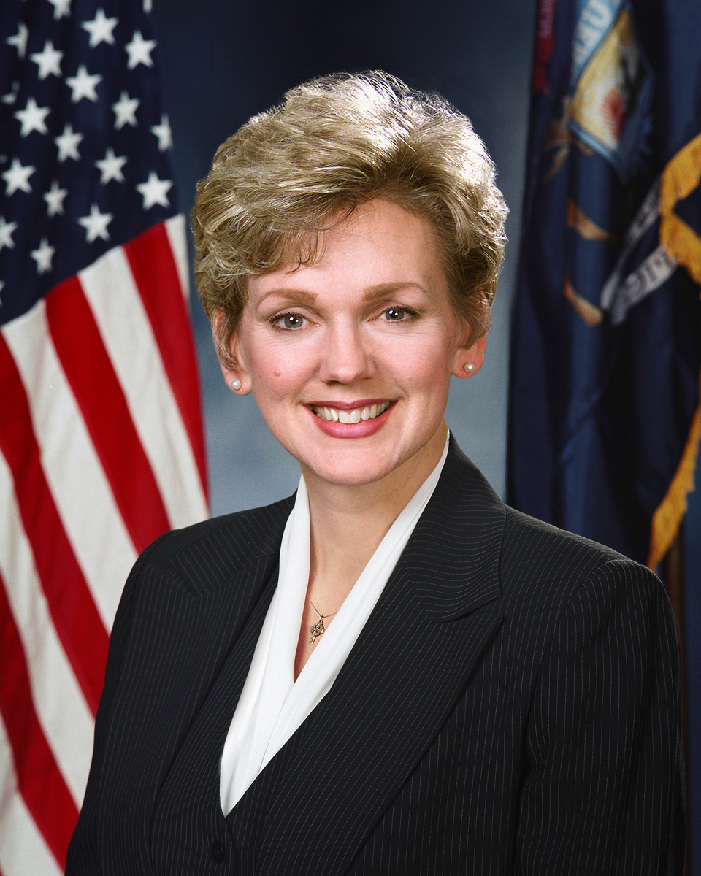
What is the Executive Branch?
The Executive Branch of Michigan is made up of the Governor, and all of the officers of our state.
Some examples of officers of the state are:
  The State Police
  The Secretary of State
  The Attorney General

Slide 4
What powers does the Executive Branch have?
The Executive Branch has the power to enforce the laws made by Congress.
The Governor must sign all bills before they become law.
She call also veto laws that she thinks will not be good for the state.

Slide 5
What other powers does the Executive Branch have?
The Executive Branch collects taxes, licenses cars, and arrests people who violate laws.
They are the enforcers!

Slide 6
An Example of Executive Power
Joe walks into a store, and sees a candy bar that he thinks would be great. He grabs the candy bar, and then runs out of the store. What happens to Joe?
(Pick an answer below)
Joe runs away and eats the candy bar for free.
Joe runs from the store, and the police arrest him.

Slide 7

Great Job!
The police would use their executive power to enforce laws, and arrest Joe for stealing.

Slide 8
Example # 2 of Executive Power
Congress passes a bill that requires students to go to school year round. The bill is sent to the Governor for her approval, but she doesn’t want the bill to become a law.
What power can she use? (Pick an answer below)
She can throw the people who wrote the bill in jail.
She can veto the bill, and stop it from becoming a law.

Slide 9
Try Again

Slide 10
Great Job!
The Governor can use her power to veto to stop the bill from becoming a law.

Slide 11
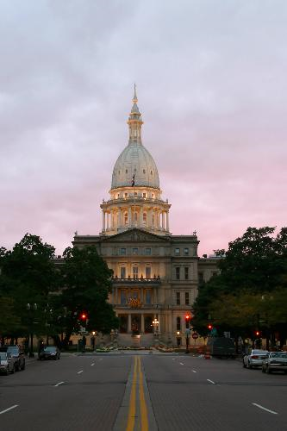
What is the Legislative Branch?
The Legislative Branch of our government is the branch that creates the laws.
It is made up of two separate groups:
  The Senate
  The House of Representatives
Notes:
http://www.city-data.com/articles/images/img2396598.jpg

Slide 12

What powers do the Legislative Branch have?
The Legislative Branch has the power to create new laws.
This branch can override a veto that was given by the Governor.
They also control how money is spent by the State of Michigan.

Slide 13
How they can the Legislative Branch overturn a veto?
Once the Governor vetoes a bill, the Legislative Branch can vote on it again to overturn the veto.
They need 2/3 of both the House of Representatives, AND the Senate to vote to overturn the veto.
If they can’t get enough votes, the bill goes away forever.

Slide 14
How a bill becomes a law…
Click on the TV screen to see a cartoon about how a bill becomes a law.
Think about the powers of the Legislative Branch, and the Executive Branch as you watch.

Slide 15
Example #1 of Legislative Powers
A person has an idea about a new state law that they think needs to be made. They want the state to require all schools to cancel recess.
Who would they have to contact to get the process started?
The Governor
A Congressman
The Mayor of their town

Slide 16
Try Again
The Governor is a member of the Executive Branch who carries out the laws.

Slide 17
Try Again
The Mayor is a member of the Executive Branch who carries out local laws.

Slide 18
Great Job!
Only a congressman can begin the process of the bill moving towards becoming a law.

Slide 19
Example #2 of Legislative Power
The bill requiring schools to cancel recess goes through Congress and is sent to the Governor for final approval. The Governor vetoes the bill.
What can Congress do if they want the bill to become a law?
Throw a fit, and put the Governor in jail.
Overturn the veto, by voting on the bill again and getting 2/3 vote of both the House of Representatives, and the Senate.

Slide 20
Try Again

Slide 21
Great Job!
By getting a 2/3 positive vote from both the House of Representatives, and the Senate, a veto can be overturned.

Slide 22
The Judicial Branch
The City of Springcreek has decided that nobody is allowed to decorate their houses for any holiday. The citizens of Springcreek are extremely upset about this decision and decide to take action. Anyone who tries to decorate is thrown in jail. What can they do?
Throw eggs at City Hall, and continue to go to jail.
Take the city to court.

Slide 23

What is the Judicial Branch?
The Judicial Branch is made up of judges who serve at different levels of the government.
The highest court in Michigan is the Supreme Court of Michigan.

Slide 24
What powers does the Judicial Branch have?
The judicial branch makes sure that all citizens are treated fairly.
They make sure that the government does not create a law that violates the Constitution of the United States, and that everyone follows the Constitution.

Slide 25
Now it’s your turn!
When you click the gavel below, you are going to be taken to a website that is going to allow YOU to become a judge.
You will get to help the Supreme Court decide a case called “Ben vs. Hamilton Middle School.” Listen to all of the details, and use your knowledge of the judicial powers to decide the case.

Slide 26
Try Again
Civil disobedience will get them put in jail.

Slide 27
Great Job!
Continue on to find out more about the courts.

Slide 28
Which branch? Question 1
Someone breaks into Joey’s house. They have taken all kind of things. He is looking for someone to help him. Which branch has the power to help Joey?
The Executive Branch
The Legislative Branch
The Judicial Branch

Slide 29
Try Again
This branch can’t help Joey.

Slide 30
Great Job!
The Executive Branch has the power to enforce laws. The police would be the right people to help Joey.

Slide 31
Which branch? Question 2
The people of Jonesville are tired of people talking on their cell phones while driving. They think that a law should be made to ban drivers using cell phones while driving. Which branch has the power to help the people of Jonesville?
The Executive Branch
The Legislative Branch
The Judicial Branch

Slide 32
Try Again
This branch can’t help the people of Jonesville.

Slide 33
Great Job!
The Legislative Branch has the power to create laws. They can vote to make a law to ban cell phones while driving.

Slide 34
Which branch? Question 3
The police have arrested Jen for walking on the “wrong” side of the street. She says that she was within her rights to walk on whatever side of the street she wanted to. Which branch has the power to decide the fate of Jen?
The Executive Branch
The Legislative Branch
The Judicial Branch

Slide 35
Try Again
This branch can’t decide what happens to Jen.

Slide 36
Congratulations!
You have proven that you are an expert on the powers of the branches!
Bravo!

